Slide 1
Advanced Programming
Prof. Shiqi Yu (于仕琪)
yusq@sustech.edu.cn
http://faculty.sustech.edu.cn/yusq/

Slide 2
C/C++ with ARM

Slide 3


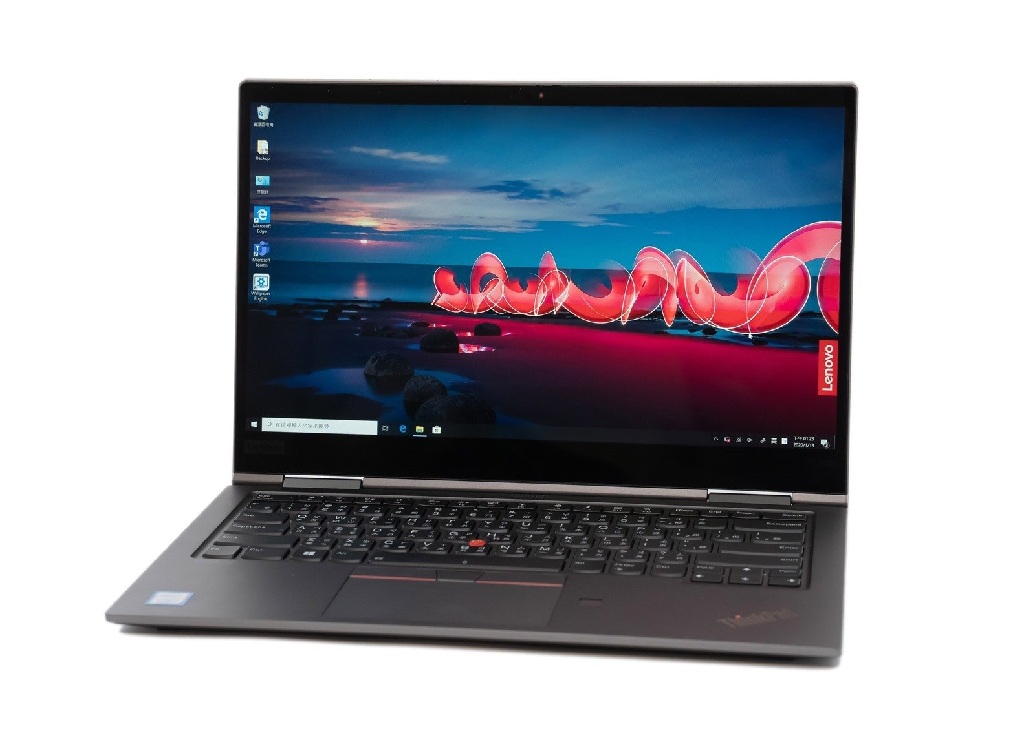
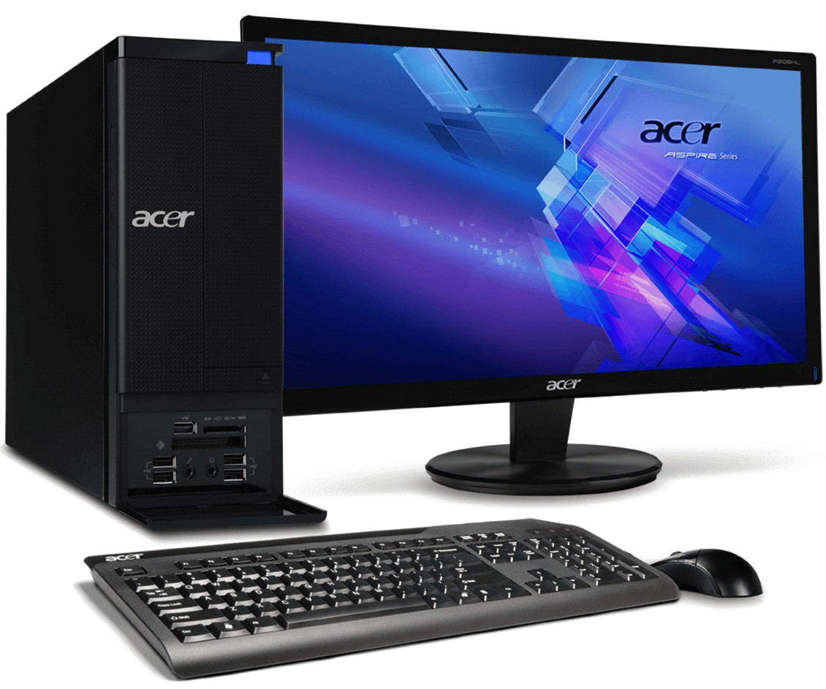
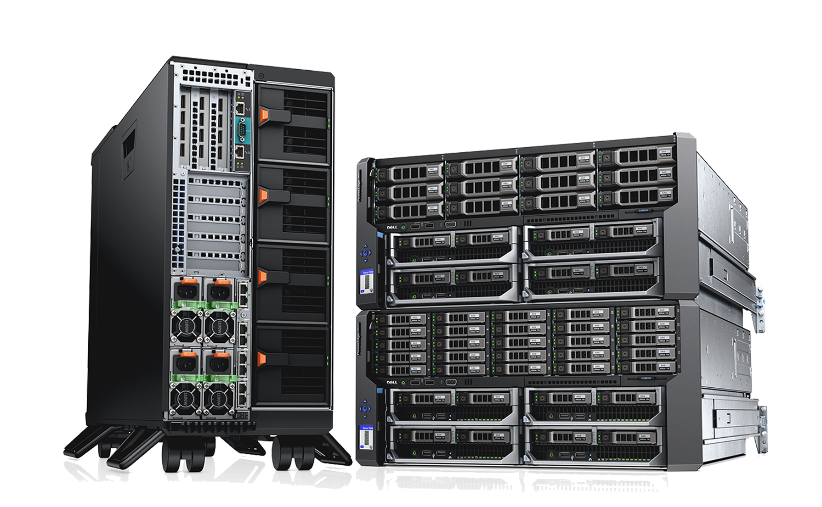
Intel vs ARM
With the help of C/C++ compilers, C and C++ are platform independent.
But we need to know some background information on different CPUs.
Intel achieved a dominant position the personal computer market. But recently ...

Slide 4

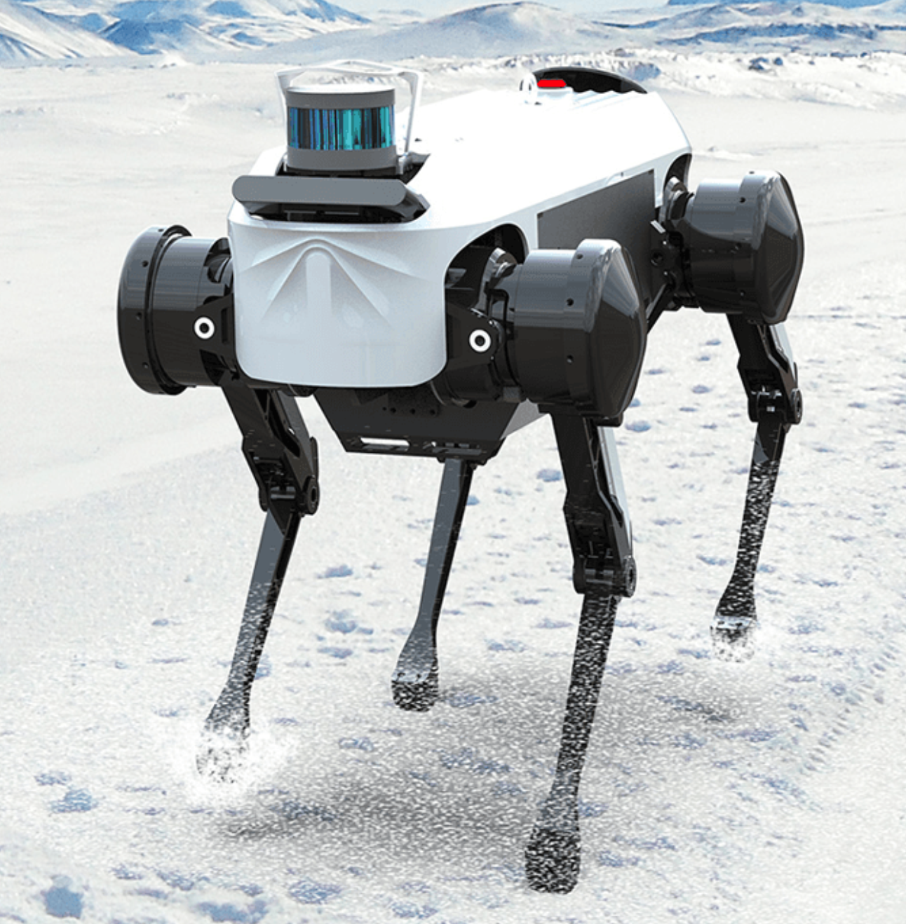
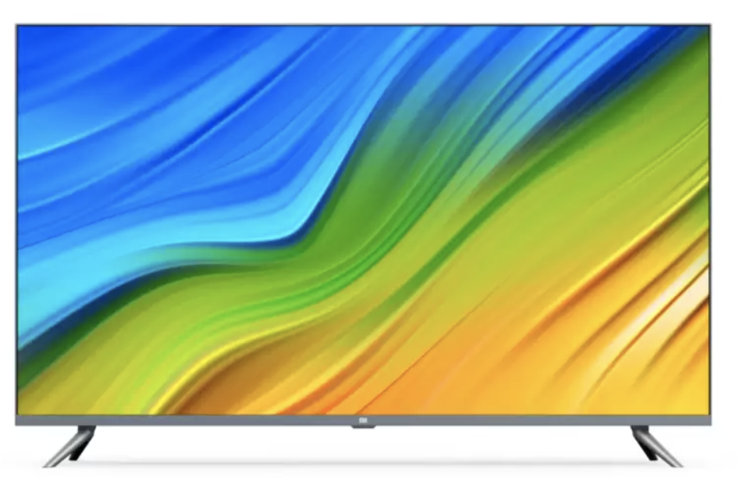
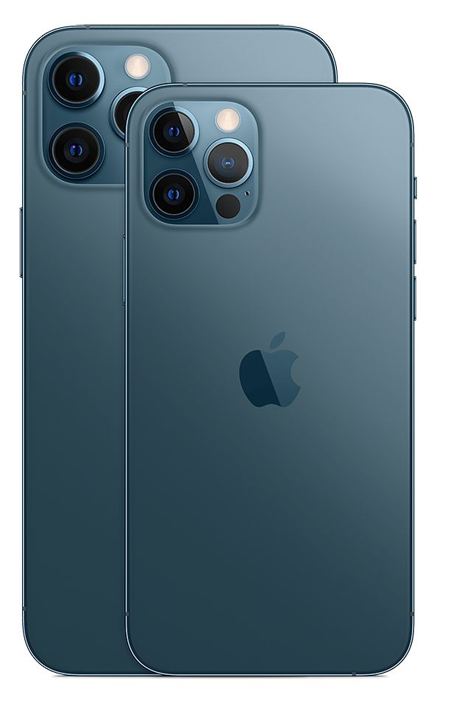
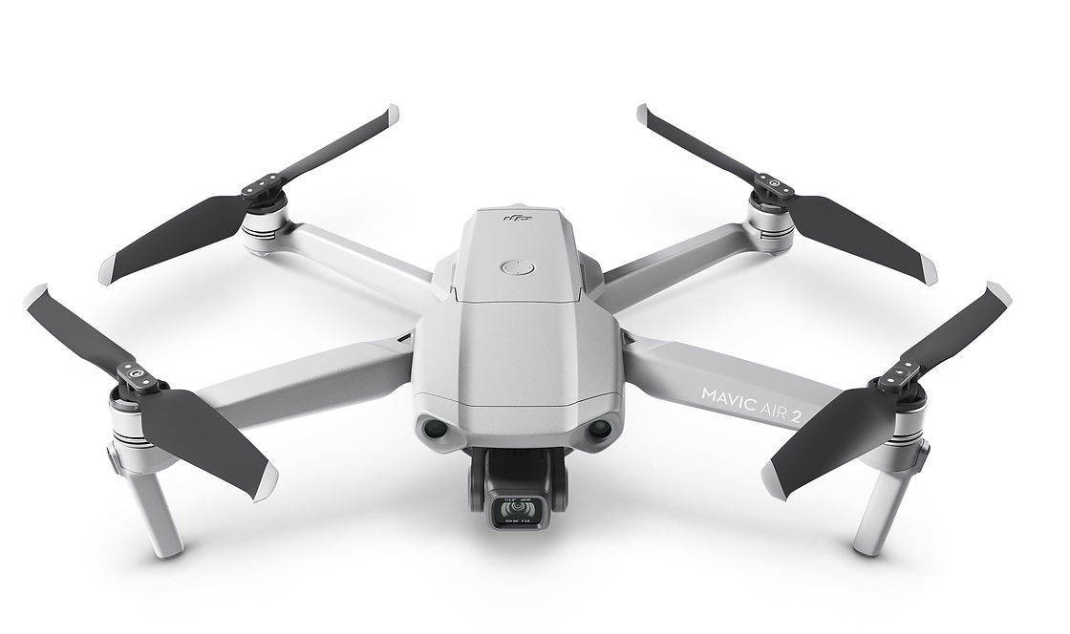
ARM
ARM (previously an acronym for Advanced RISC Machine and originally Acorn RISC Machine) is a family of reduced instruction set computing (RISC) architectures for computer processors¹.
ARM is the most widely used instruction set architecture (ISA) and the ISA produced in the largest quantity.
1. https://en.wikipedia.org/wiki/ARM_architecture

Slide 5

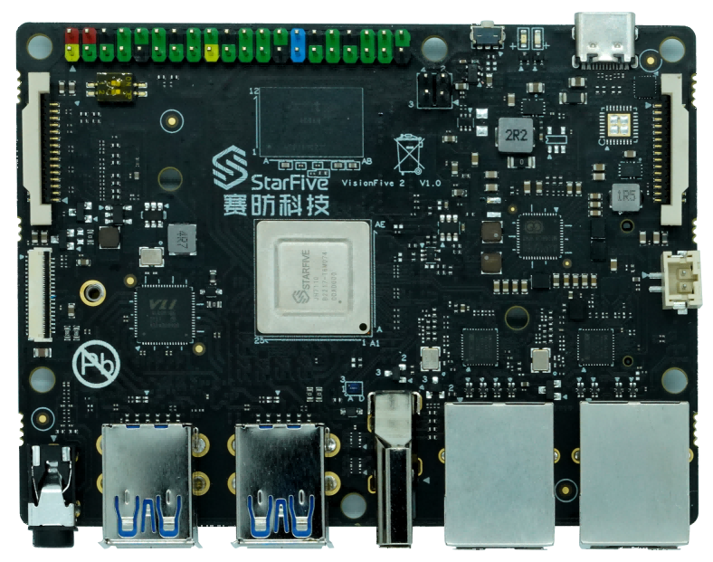
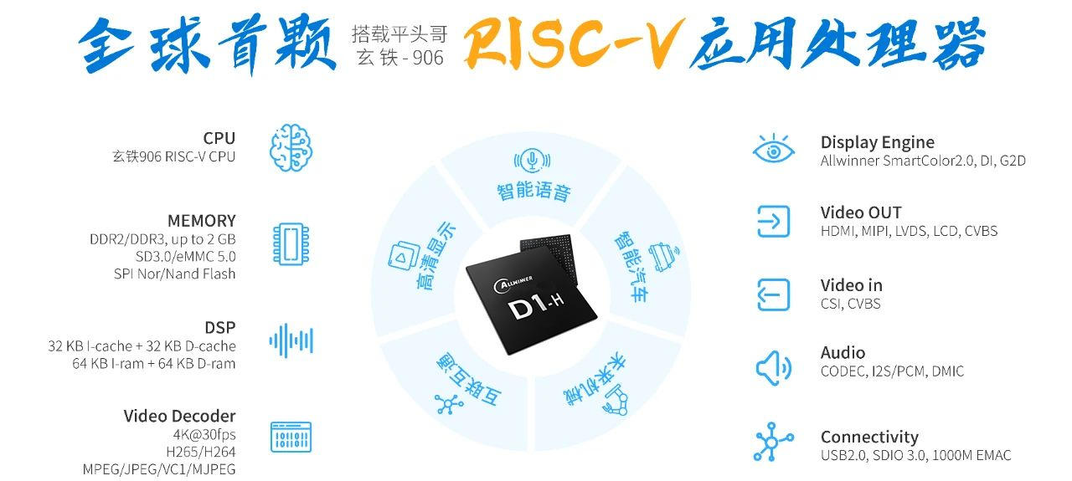
RISC-V
An open standard instruction set architecture (ISA) based on established reduced instruction set computer (RISC) principles.
RISC-V is provided under royalty-free open-source licenses.
Allwinner D1
StarFive JH7110

Slide 6

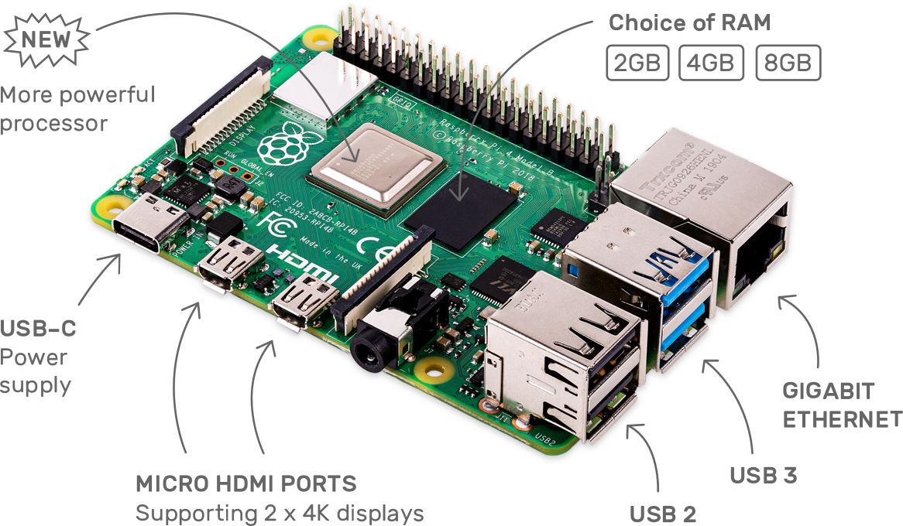
Raspberry Pi 4
https://www.raspberrypi.org/
Broadcom BCM2711, Quad core Cortex-A72 (ARM v8) 64-bit SoC @ 1.5GHz
2GB, 4GB or 8GB LPDDR4-3200 SDRAM (depending on model)
2.4 GHz and 5.0 GHz IEEE 802.11ac wireless, Bluetooth 5.0, BLE
Gigabit Ethernet
2 USB 3.0 ports; 2 USB 2.0 ports.
Raspberry Pi standard 40 pin GPIO header (fully backwards compatible with previous boards)
2 × micro-HDMI ports (up to 4kp60 supported)

Slide 7
How to develop programs with ARM Development boards
Almost the same with an X86 PC with Linux OS.
gcc/g++
Makefile
cmake

Slide 8
Speedup Your Program

Slide 9
Principle for Programming
Simple is Beautiful !
Short
Simple
Efficient

Slide 10
Some Tips on Optimization
Choose an appropriate algorithm
Clear and simple code for the compiler to optimize
Optimize code for memory
Do not copy large memory
No printf()/cout in loops
Table lookup (sin(), cos() ...)
SIMD, OpenMP

Slide 11
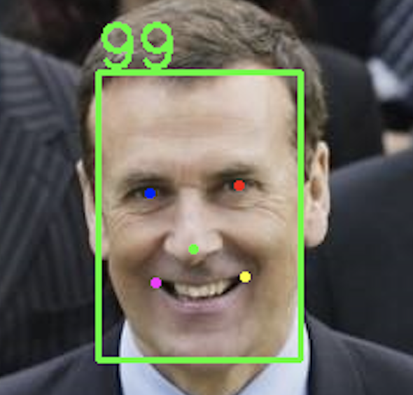
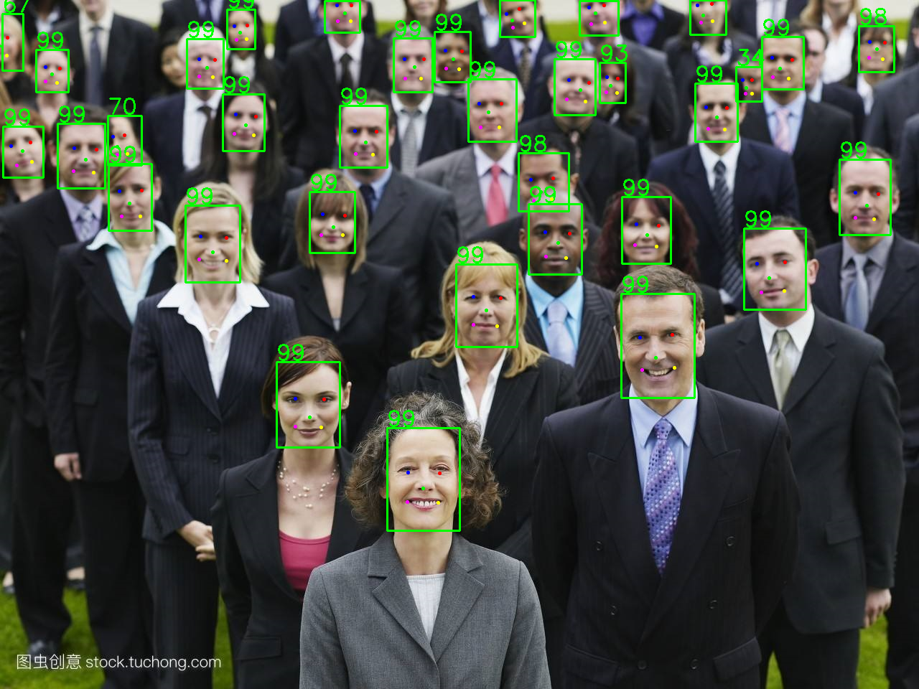
An example: libfacedetection
Face detection and facial landmark detection in 1600 lines of source code
facedetectcnn.h :
400 lines
CNN APIs
facedetectcnn.cpp:
900 lines
CNN function definitions
facedetectcnn-model.cpp:
300 lines
Face detection model
facedetectcnn-int8data.cpp
CNN model parameters in static variables
https://github.com/ShiqiYu/libfacedetection/

Slide 12
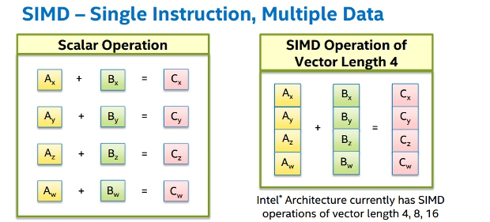
SIMD: Single instruction, multiple data
Intel: MMX, SSE, SSE2, AVX, AVX2, AVX512
ARM: NEON
RISC-V: RVV(RISC-V Vector Extension)
https://software.intel.com/sites/landingpage/IntrinsicsGuide/

Slide 13

SIMD in OpenCV
"Universal intrinsics" is a types and functions set intended to simplify vectorization of code on different platforms.
https://docs.opencv.org/master/df/d91/group__core__hal__intrin.html
使用OpenCV中的universal intrinsics为算法提速(1)(2)(3)
https://mp.weixin.qq.com/s/_dFQ9lDu-qjd8AaiCxYjcQ
https://mp.weixin.qq.com/s/3UmDImwlQwGX50b1hvz_Zw
https://mp.weixin.qq.com/s/XtV2ZUwDq8sZ8HlzGDRaWA

Slide 14

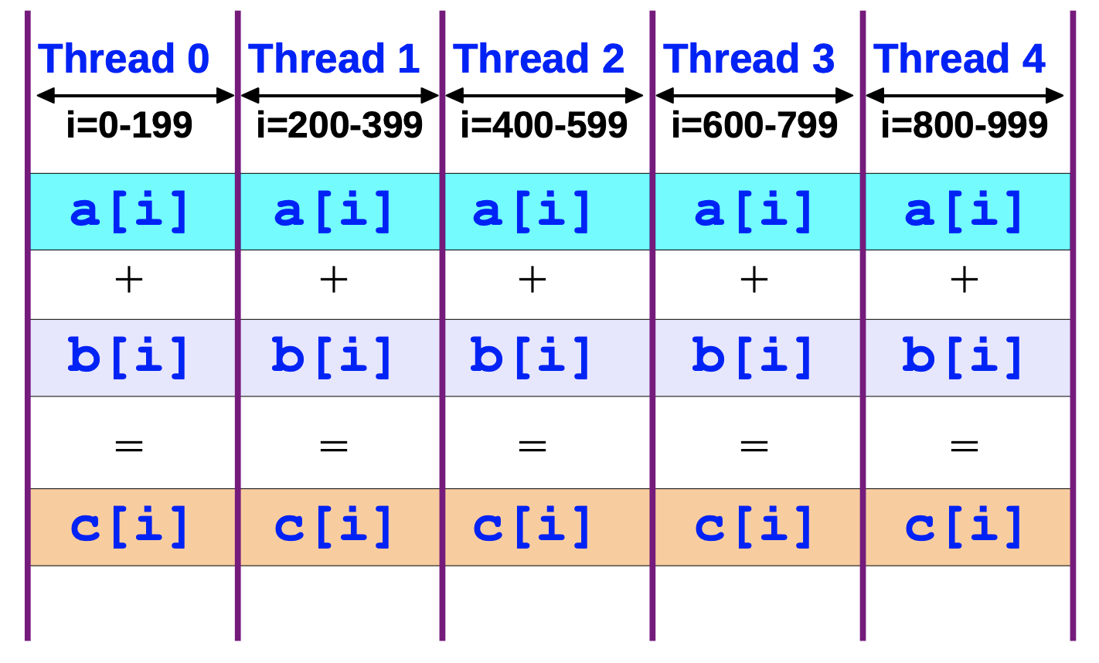
An Overview of OpenMP – Ruud van der Pas – Sun Microsystems https://www.openmp.org/wp-content/uploads/ntu-vanderpas.pdf
#include <omp.h>
#pragma omp parallel for
for (size_t i = 0; i < n; i++)
{
c[i] = a[i] + b[i];
}

Slide 15
Where should #pragma be? The 1st loop or the 2nd?
#include <omp.h>
#pragma omp parallel for
for (size_t i = 0; i < n; i++)
{
//#pragma omp parallel for
for (size_t j = 0; j < n; j++)
{
//...
}
}

Slide 16
An Example with SIMD and OpenMP

Slide 17
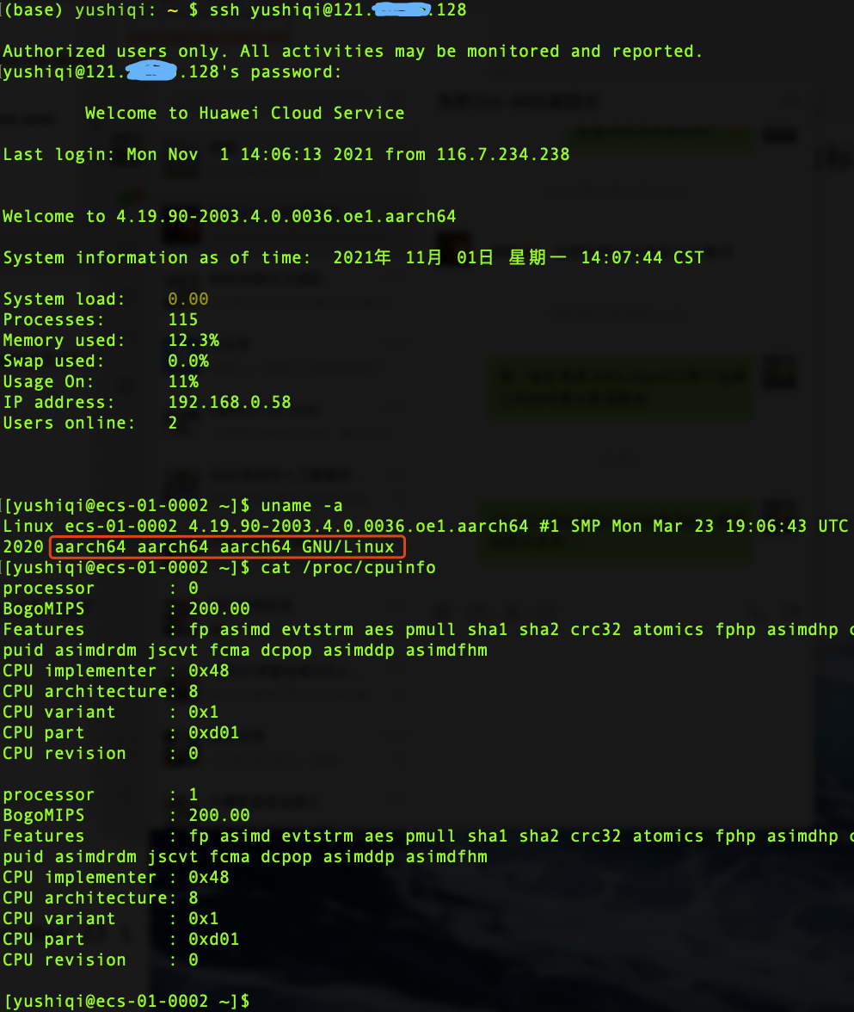
ARM Cloud Server
Huawei ARM Cloud Server
Kunpeng 920 (2 cores of many)
RAM: 3GB
openEuler Linux

Slide 18
Functions for dot product
float dotproduct(const float *p1, const float * p2, size_t n);
float dotproduct_unloop(const float *p1, const float * p2, size_t n);
float dotproduct_avx2(const float *p1, const float * p2, size_t n);
float dotproduct_avx2_omp(const float *p1, const float * p2, size_t n);
float dotproduct_neon(const float *p1, const float * p2, size_t n);
float dotproduct_neon_omp(const float *p1, const float * p2, size_t n);

Slide 19
Avoid Memory Copy
A trick in OpenCV

Slide 20
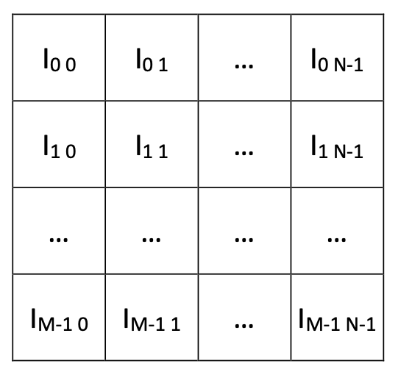
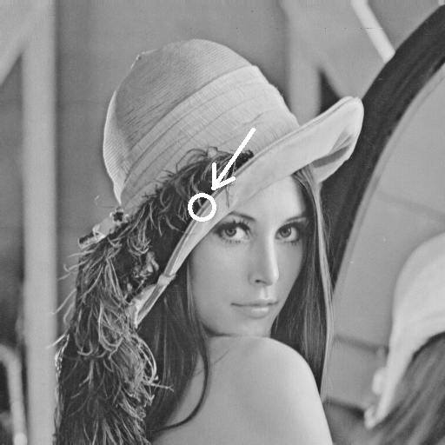

What’s an image?

Slide 21
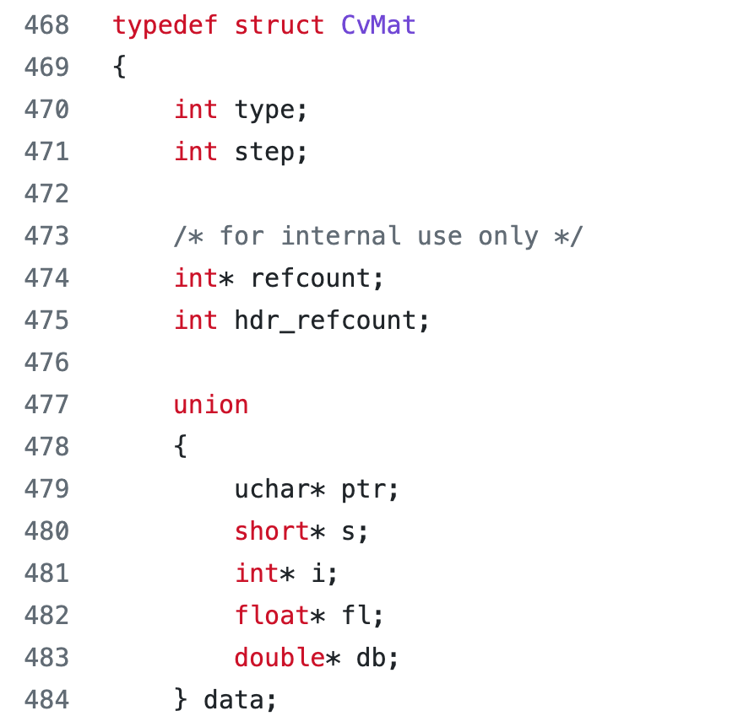
CvMat struct
modules/core/include/opencv2/core/types_c.h

Slide 22
step in CvMat struct
How many bytes for a row of Matrix 4(row)x3(col)?
Can be 3, 4, 8, and any other values >=3.
Memory alignment for SIMD

Slide 23
ROI: Region of interest
CvMat A
rows=100
cols=100
step=100
data=0xABCDEF00
CvMat B
rows=100
cols=100
step=100
data=0xABCDEF00
CvMat C
rows=30
cols=28
step=100
data=0xABCE0698

